Slide 1

IT-648: IT Risk Management
Week 15
Sonja Streuber

Slide 2
Agenda
# | Topic | Reading | Due 11:59 pm CST on Blackboard
15 | Course Summary & certification paths: The NIST 800-39 framework, Sarbanes-Oxley compliance | Agrawal 14 Other materials on Blackboard | W: Post F: Responses S: LAB_15

Slide 3
Chapter 14
IT risk analysis and management

Slide 4
Overview
By the end of this week, you will be able to:
Explain the relevance of risk management to top management
Describe IT Risk management frameworks
Perform Risk analysis - identification and assessment
Perform Risk management - mitigation, preparation and response

Slide 5
Introduction
Risk
Quantitative measure of the potential damage caused by a specified threat
Draws top management attention
Integrates almost everything discussed in previous chapters
Risk management framework
NIST
Utilize inputs from both technology and management experts
Risk management is a component of managing an organization

Slide 6
Risk management as component of general management
Performance of organization assessed using some measure of profitability
More profitable organizations are more valuable than less profitable organizations
Manager’s decision problem
= max(profit)
= max(Revenues – cost)
Goal can be accomplished by
Increasing revenues
Reducing costs
Unusual incidents can affect organization’s profits
They need to be managed
At a very high level
Risk management
Managing financial impacts of unusual events

Slide 7
Risk management as component of general management
Risk management = manager’s decision problem:
Max (Revenues – cost - Δ)
Δ is the impact of unusual events on the organization
Two approaches to risk management
Making risks (Δ) predictable
Insurance and hedging
Performed by financial sector of the economy
E.g. flood insurance for data center makes the financial impact of flood events predictable
Equal to the annual premium paid to buy the insurance
Unusual for techies to think about, but second nature to top management
Be prepared
Not authors’ expertise, so left to other experts
Minimizing and preparing for these risks

Slide 8
Alternate view of importance of risk
Offense and defense
All sports teams have a mix of offense and defense
In IT
Typical IT investments may be seen as offensive measures
Attack costs
Attack complexity
Battle for customers in more markets
Information security is the defensive arm of the equation
Focuses on ensuring that the organization’s existing competitive advantage is not lost due to improper IT implementations
Related area is ensuring that new risks created in organization due to IT investments are well managed
E.g. high speed trading
Quote
Offense sells tickets, defense wins championships

Slide 9
Risk management framework
Popular risk management frameworks
CERT’s OCTAVE
ISO 27002
NIST Risk Management Framework
Recommendations from Microsoft
Recommendations from Google
Creativity
Adoption (& tailoring) of one of the standard risk-management frameworks is strongly recommended
Developing own risk-management plan from scratch is dangerous--very likely to miss many important concerns
Similar ideas: Collective efforts of best minds in industry to manage IT risks
Pick most suitable guideline for your organization

Slide 10
NIST 800-39 framework
NIST recommendations for managing information security risk
Published as special publication 800-39.
Version at time of writing dated March 2011
Developed with inputs from the Civil, Defense, and Intelligence Communities
Provide information security framework for the federal government.
Very general
Useful for vast majority of commercial and non-profit organizations
High-security environments such as military bases or special laws such as HIPAA will use more stringent procedures
http://nvlpubs.nist.gov/nistpubs/Legacy/SP/nistspecialpublication800-39.pdf
NOW NIST Risk Management Framework at http://csrc.nist.gov/groups/SMA/fisma/framework.html

Slide 11
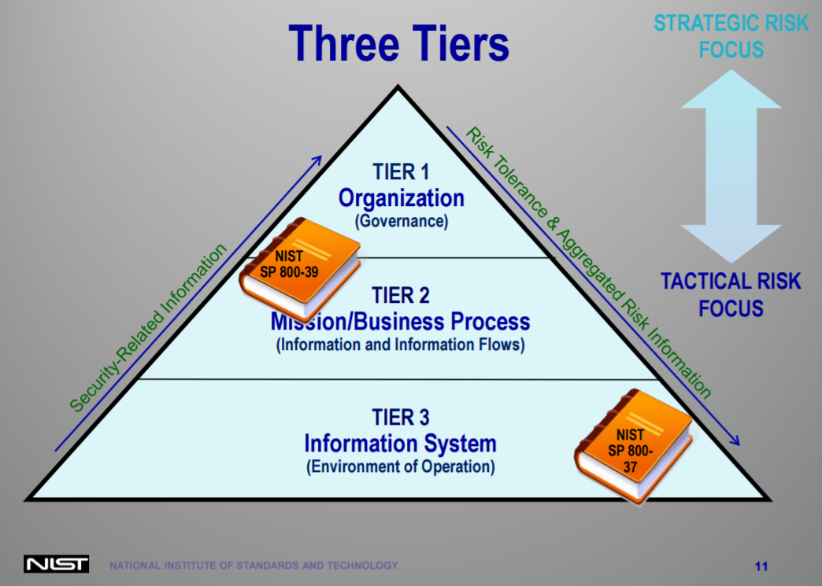
NIST Risk Management Framework
Great overview here: http://csrc.nist.gov/groups/SMA/fisma/documents/rmf_overview_6-9-14.pdf

Slide 12
NIST Risk Management Framework
Step 1: Categorize
Categorize the system and the information processed, stored, and transmitted by that system based on an impact analysis.
Step 2: Select
Select an initial set of baseline security controls for the system based on the security categorization; tailoring and supplementing the security control baseline as needed based on organization assessment of risk and local conditions.
Step 3: Implement
Implement the security controls and document how the controls are deployed within the system and environment of operation.
See appropriate NIST publication in the publications section.
Step 4: Assess
Assess the security controls using appropriate procedures to determine the extent to which the controls are implemented correctly, operating as intended, and producing the desired outcome with respect to meeting the security requirements for the system.
Step 5: Authorize
Authorize system operation based upon a determination of the risk to organizational operations and assets, individuals, other organizations and the Nation resulting from the operation of the system and the decision that this risk is acceptable.
Step 6: Monitor
Monitor and assess selected security controls in the system on an ongoing basis including assessing security control effectiveness, documenting changes to the system or environment of operation, conducting security impact analyses of the associated changes, and reporting the security state of the system to appropriate organizational officials .
See http://csrc.nist.gov/groups/SMA/fisma/framework.html

Slide 13
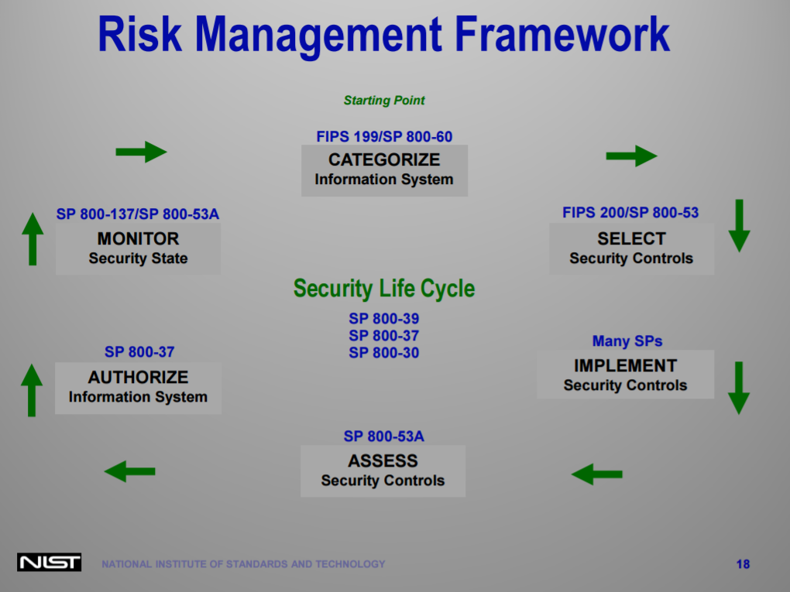
NIST Risk Management Framework
Great overview here: http://csrc.nist.gov/groups/SMA/fisma/documents/rmf_overview_6-9-14.pdf

Slide 14
NIST 800-39 Framework
Policy last updated in March 2011
IT risk
Defined as risk associated with the use of information systems in an organization
One of many risks facing organizations
NIST recognizes that risk management is not an exact science
Recommends that senior leadership be involved in IT risk management
IT risk management be integrated in the design of business processes
Risk Management Components

Slide 15
Risk Frame
Establishes the context for risk management by describing the environment in which risk-based decisions are made
Clarifies to all members in the organization the various risk criteria used in the organization
Criteria include
Assumptions about the risks that are important
Responses that are considered practical
Levels of risk considered acceptable
Priorities and trade-offs when responding to risks
Also identifies any risks that are to be managed by senior leaders/executives
Example: 2001 9/11 attack brought renewed attention to terrorism and the heightened need to secure IT resources

Slide 16
Risk Assessment
Identifies and aggregates risks facing the organization
Within the context of the risk frame, the
Recall definition of risk
Quantitative measure of the potential damage from a threat
Risk assessment develops these quantitative estimates
Identifying threats
Identifying vulnerabilities in the organization
Identifying harm to the organization if the threats exploit vulnerabilities
Discussed in greater detail in next section

Slide 17
Risk Response
Addresses how organizations respond to risks once they are determined from risk assessments
Helps in the development of a consistent, organization-wide, response to risk
Consistent with risk frame
Following standard business procedure, risk response consists of
Developing alternative courses of action for responding to risk
Evaluating these alternatives
Selecting appropriate courses of action
Implementing risk responses based on selected courses of action

Slide 18
Risk Monitoring
Evaluates effectiveness of organization's risk management plan over time
Involves
Verification that planned risk response measures are implemented
Verification that planned risk responses satisfy the requirements derived from the organization’s missions, business functions, regulations, and standards
Determination of effectiveness of risk response measures
Identification of required changes to risk management plan as result of changes in technology and business environment

Slide 19
NIST 800-39 Framework – contd.
Activities in outer circles performed sequentially
Move from risk assessment to risk response to risk monitoring
Risk frame informs all sequential step-by-step activities
E.g.
Threats identified from risk frame serve as inputs to risk assessment
Outputs from risk assessment component (risks) serve as input to risk response component
Originally, NIST uses bi-directional arrows in figure; directed arrows above represent sequential nature of activities and information flows

Slide 20
NIST risk assessment vs. risk analysis
The risk assessment component in NIST 800-39 framework includes two activities
Identifying risks
Quantifying these risks
NIST risk assessment is often also called risk analysis
In this usage, quantification activity of NIST risk assessment is called risk assessment

Slide 21
Risk Assessment Model
THREAT analysis limited to identifying potential problems
RISK assessment adds an analysis of outcomes to identified threats
Risk = damage(threat)
i.e. risk is the damage output as a function of the threat input
Since threat is composed of actor, motive and asset,
Risk = damage(actor, motive, asset)

Slide 22
Risk assessment model – contd.
Risks are captured as risk statements.
Use “if/ then” or “may” structure to capture risk trigger, condition and likelihood, consequence, root cause (if known)
Example Threat:
Risk 1
A remote hacker may steal user credentials, with the intent to try these credentials on banking web sites. This may lead to lawsuits, which will drain profits as well as management time
Risk 2
A remote hacker may steal user credentials, with the intent to try these credentials on banking web sites. This may lead to adverse publicity, which may hurt our business in the short term
Actor:
Asset:
Motive:
Remote hacker
User credentials database
Try credentials on banking web sites

Slide 23
Risk assessment model and risk frame
Risks are combinatorial
Multiply rapidly
Example
2 actors (remote attacker and disgruntled employee)
2 assets (information assets and hardware assets)
4 potential threats (2 * 2) if only 1 motive
Add two forms of damage
Financial loss, information loss
8 potential risks to consider (4 * 2)
Even smallest real-world organizations have tens of assets, actors, motives and damages
Tens of thousands of potential risks
Most organizations can only deal with, say, 5 – 10 risks at any time
Hence risk frames are important
Prune out unlikely risks
Develop organizational consensus on pruned risks

Slide 24
Quantifying risks
Once risks are identified
Quantitative measures for risks can be developed
Two measures estimated
Likelihood of risk
Potential damage upon occurrence of the risk
Risk = likelihood * damage
E.g.
Say probability of such an attack in the coming year = 1%
Also, say that monetary damage from lost sales is $10,000 in profits
Risk = likelihood * magnitude = 0.01 * $10,000 = $100
All risks within the risk frame can be prioritized

Slide 25
Other risk management frameworks
General frameworks
International Standards Organization (ISO)
OCTAVE
Context-specific frameworks
Sarbanes-Oxley
IT general controls for reliability of financial reporting by publicly traded companies

Slide 26
International Standards Organization (ISO)
Reserved ISO 27000 series of standards for information security matters
i.e. standards starting with the digits 27
As of Dec. 2012
Includes 6 standards
ISO 27001 – ISO 27006
On next slide
Note parallels between NIST 800-39 and ISO 27001 standards
NIST assess phase maps to ISO plan phase
NIST respond phase maps to ISO do phase
NIST monitor phase maps to ISO check and act phases

Slide 27
ISO Standards
ISO 27001
Specifies the requirements for an information security management system (ISMS)
ISO 27002
Specifies a set of controls to meet the requirements specified in ISO 27001
ISO 27002-27006
ISO 27003: Guidance for the implementation of an ISMS
States that ISO adopts a process approach for implementing information security
All processes follow Deming’s Plan-Do-Check-Act (PDCA) model
Planning phase
Organizations establish policies and procedures to manage information risks
Do phase
These procedures are operated
Checking phase
Performance is measured against plan specifications and presented to management for review
Act phase
Review results are used to improve policies and procedures in the next iteration of the plan phase
Documents a set of security techniques
Map to the controls we have discussed throughout the class
Controls are divided into the following sections
Asset management
Human resources security
Physical and environmental security
Communications and operations management
Access control
Information systems acquisition, development and maintenance
Information security incident management
Business continuity management
Compliance
ISO 27004: Measurement and metrics for an ISMS
ISO 27005: Standard for information security risk management
Information security risk management process consists of 7 sequential steps
Context establishment
Risk assessment
Risk treatment
Risk acceptance
Risk treatment plan implementation
Risk monitoring and review
Risk management process improvement
Alignment with the 4 phases defined in ISO 27001 shown on next slide
ISO 27006: Guidelines for accreditation of organizations that offer ISMS certification

Slide 28
ISO 27001 and ISO 27005
Information security (IS) management system process stage (ISO 27001) | IS risk management process stage (ISO 27005)
Plan | Context establishment Risk assessment Developing risk treatment plan Risk acceptance
Do | Implementation of risk treatment plan
Check | Continual monitoring and reviewing of risks
Act | Maintain and improve IS risk management process

Slide 29
OCTAVE
Operationally Critical Threat, Asset, Vulnerability Evaluation
Corresponds to risk assessment phase of NIST 800-39
Developed with large organizations in mind
300 employees or more
Generally maintain their own IT infrastructure
Can manage their own information security operation
Developed by Software Engineering Institute (SEI)
Located at Carnegie Mellon University (CMU)
Federally funded organization
Taken stewardship for coordinating various activities important to the software industry
E.g. recommended guidelines for improving the software development process (CMMI)
CERT
Maintains central repository of bug reports released by major software vendors

Slide 30
OCTAVE – contd.
Three-phased approach to examine organizational and technology issues
Assembles comprehensive picture of the organization's information security needs
Activities supported by a catalog of good or known practices incl. surveys and worksheets
Used to elicit and capture information during focused discussions and problem-solving sessions
Many parallels
OCTAVE and ISO 27000
OCTAVE and NIST 800-39
Phase 1:
Phase 2:
Phase 3:
Identifying critical assets and the threats to those assets
Identifying vulnerabilities, both organizational and technological, that expose those threats, creating risk to the organization
Developing practice-based protection strategy and risk mitigation plans to support the organization's mission and priorities

Slide 31
Sarbanes-Oxley Act
Sarbanes-Oxley (SOX) Act of 2002 (formally known as the Public Company Accounting Reform and Investor Protection Act) and the Public Company Accounting Oversight Board (PCAOB) were created to restore investor confidence in U.S. public markets.
Holds corporate CEOs and CFOs accountable for the adequacy and effectiveness of their internal controls related to financial transactions and reporting, including the quality and integrity of information generated by their company’s applications and communications, as well as the infrastructure that supports those applications—increased reliance on IS managers to implement, manage, and monitor the applicable controls
Goal: Enhance corporate responsibility, enhance financial disclosures, and deter corporate and accounting fraud.
Controls: Confidentiality, integrity, and availability of financial data; must be audited externally, statement of control must be included in the annual corporate report filed with the SEC.

Slide 32
Sarbanes-Oxley Act: Key Sections
Section 101: PCAOB
Established as the governing agency to create auditing standards and rules for public companies and given the authority to regulate the accounting firms that audit public companies.
Section 404
CEO and CFO attest that internal controls are in place, documented, and effective. Management assessment contains four parts.
Mgmt responsibility for existence and rigidity of internal controls
Evaluation of the effectiveness of internal controls
Statement of the framework used to evaluate the effectiveness of controls
The company’s external auditor must separately attest that management’s statement concerning the effectiveness of internal controls is accurate.
Management is prohibited from stating that internal controls are effective if one or more material weaknesses exist in the controls.

Slide 33

Sarbanes-Oxley Act: Key Sections
Section 302: CEO & CFO & Auditor
CEO&CFO
Responsible for all internal controls and for reporting quarterly on any significant changes to internal controls that could affect the company’s financial statement.
Must certify that they are responsible for and knowledgeable about all financial statements submitted quarterly and annually.
Must certify that they have knowledge of the design and have evaluated the effectiveness of all internal controls and that these controls ensure that complete and accurate information is reported to them.
Significant changes to disclosure controls and any deficiencies, weaknesses, or fraudulent acts that may compromise the accuracy of reporting must be disclosed.
External Auditor
Evaluates internal controls to determine whether modifications need to be made for accuracy and compliance.
Must attest that he or she has reviewed management’s assessment of internal controls and has approved the process and evaluation of that assessment

Slide 34
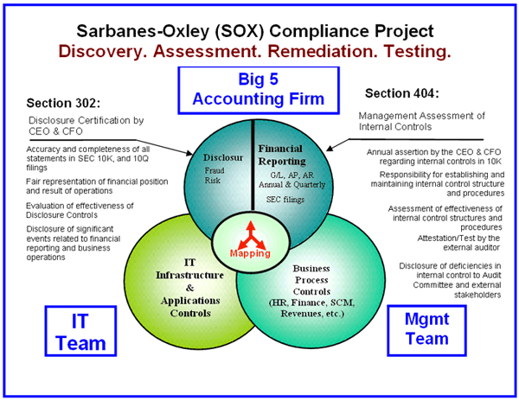
Sarbanes-Oxley Act: Key Sections
http://www.iim-edu.org/thinktank/publications/executive-journal/corporate-governance-sarbanes-oxley-best-practices-paper/index.htm

Slide 35
Sarbanes-Oxley Act: Key Sections
Section 409
CEO and CFO will ensure “rapid and current public disclosure” of any material event that could affect the company’s financial or operational performance (company restructuring, key personnel changes, budget overruns on IT projects, stock sales by corporate officers, new financial or operational application that may “not work.”
Section 906
Every periodic report with financial information must be accompanied by a written statement by the CEO and CFO.
The content of this report fairly represents the financial condition of the company.
Fines and prison terms for either knowingly or unknowingly submitting a false statement. Also criminal penalties for failure of corporate officers to certify the financial reports in a timely manner.

Slide 36

Sarbanes-Oxley Act: Key Sections
Public Company Auditing
Oversight Board (PCAOB)
Auditing Standard No. 2
On March 9, 2004, PCAOB approved Auditing Standard No. 2, “An Audit of Internal Control over Financial Reporting Performed in Conjunction with an Audit of Financial Statements.”
Establishes requirements for performing an audit of internal control over financial reporting and provides important directions on the scope and approach required of corporation management and external auditors.
Provides guidance on the controls that should be considered, including program development, program changes, computer operations, and access to programs and data.
Addresses financial reporting controls that should be in place for a period before the attestation date and the controls that may operate after the attestation date.
Supplemented and simplified by Auditing Standard no. 5 in 2007.

Slide 37
Sarbanes-Oxley Act: Impact on IT
Enterprise applications and services support creation, storage, processing, and reporting of financial transactions → SOX compliance must include controls for the use of technology in data handling, processing, and reporting (=general controls), no matter whether services are provided in-house or outsourced.
Challenges: Consistency, Documentation, Communication
IT departments must formally address and manage the design, documentation, implementation, testing, monitoring, and maintenance of IT internal controls for all applications, data, networking, contracts, licenses, telecommunications, and physical environment. This includes third-party services.
To date, audits have identified the following weaknesses among corporations:
Consistency, documentation, and communication.
Lack of a comprehensive strategic plan concerning how IT can best serve the overall business objectives.
Together, these omissions lead to weak security and an uncontrolled or inconsistent architecture.

Slide 38
SOX audit directions for IT
Section 21 of AS 5
Overall direction of SOX audit
Section 36 of AS 5
Directs auditors to two paragraphs below
Paragraph 29 of AS 12
Directs auditors to paragraph below
Appendix B of AS 12
Controls
AS 5
Audit of internal controls
AS 5 → Para 21
Top-down approach
AS 5 → Para 36
Effect of IT on transaction flow
AS 12 → Para 29
Refer to appendix B
AS 12 → Appendix B
Unauthorized access etc

Slide 39
AS 5
Section 21.
The auditor should use a top-down approach to the audit of internal control over financial reporting to select the controls to test. A top-down approach begins at the financial statement level and with the auditor's understanding of the overall risks to internal control over financial reporting. The auditor then focuses on entity-level controls and works down to significant accounts and disclosures and their relevant assertions
Section 36.
The auditor also should understand how IT affects the company's flow of transactions. The auditor should apply paragraph 29 and Appendix B of Auditing Standard No. 12, Identifying and Assessing Risks of Material Misstatement, which discuss the effect of information technology on internal control over financial reporting and the risks to assess

Slide 40
AS 12
Section 29
The auditor also should obtain an understanding of how IT affects the company's flow of transactions. (See Appendix B.)
APPENDIX B – CONSIDERATION OF MANUAL AND AUTOMATED SYSTEMS AND CONTROLS
B4. The auditor should obtain an understanding of specific risks to a company's internal control over financial reporting resulting from IT. Examples of such risks include:
Reliance on systems or programs that are inaccurately processing data, processing inaccurate data, or both;
Unauthorized access to data that might result in destruction of data or improper changes to data, including the recording of unauthorized or non-existent transactions or inaccurate recording of transactions (particular risks might arise when multiple users access a common database);
The possibility of IT personnel gaining access privileges beyond those necessary to perform their assigned duties, thereby breaking down segregation of duties;
Unauthorized changes to data in master files;
Unauthorized changes to systems or programs;
Failure to make necessary changes to systems or programs;
Inappropriate manual intervention; and
Potential loss of data or inability to access data as required

Slide 41
Sarbanes-Oxley Act: Controls
Areas of Emphasis: Security, change management, problem management, integrity of the technology infrastructure for processing, storage, and communication of financial data (esp. data warehouses)
Audit in each IT area must integrate automated and manual controls at the business-process level.
The following IT controls must be documented and evaluated as effective to be in compliance with SOX requirements:
Access control
Change control
Data management
IT operations
Network operations
Asset management

Slide 42
Sarbanes-Oxley Act: Controls
Access Control
Security administration must have an effective, documented process for monitoring and enforcing the security policies dictated by management (incl. data security, password aging, etc.)
These policies and processes must be communicated to all user groups.
Execution of financial transactions or transactions that lead to financial transactions must be limited to those individuals who have an authorized business reason to do so.
Access to financial and “protected personal” data likewise must be limited to those individuals who have an authorized business reason for access.
Change Control
Must cover changes to financial applications, all interface applications, operating systems that control the desktop and host server, productivity tools used to create summary analysis, database management systems, and networks. Should also include interface systems, database infrastructure, operating systems, network systems, or hardware configurations.
The change process must provide:
Points for management review
Authorization
Migration of changed components
Change scheduling
Management reporting
Communication of changes to the user community
Inadequate change-control methods can lead to loss of information integrity in financial applications and data systems

Slide 43
Sarbanes-Oxley Act: Controls
Data Management: Encompasses both logical and physical data management as well as identification and protection of critical data, especially data related to financial processing and reporting.
Data Transfer: Timing and frequency of downloads from interface systems to a financial data warehouse or enterprise resource planning (ERP) system must be consistent, timely, and complete with validation routines
Database Structures: Compatibility of database management systems used to store financial data to ensure integrity of summation, interpretation, and analysis can be jeopardized.
Data-Element Consistency: If multiple accounting systems are used, metadata files and data dictionaries must exist to ensure consistent interpretation of key data elements.
Physical Control of Data: If the facilities where servers, workstations, and hard-copy reports are located are not secured, unauthorized viewing or change may compromise transactions and/or data.
Data Backup: Backup timing and frequency should be determined by the business need for short-term recovery of data in problem situations. Disaster recovery and business continuity plans currently not part of SOX requirements

Slide 44
Sarbanes-Oxley Act: Controls
IT Operations
IT operations controls cover the definition, acquisition, installation, configuration, integration, and maintenance of the IT infrastructure, including:
Day-to-day service-level mgmt
Management of third-party services
System availability
Client services
Configuration and systems mgmt
Problem mgmt and resolution
Operations mgmt scheduling
Facilities mgmt
The system software component of operations includes controls over acquisition, implementation, configuration, and maintenance of operating system software, database management systems, middleware software, network communications software, security software, and utilities. Also incident tracking, logging, and monitoring.
Network Operations
Audit includes review of entry points to the wide area network or local area network, incl. proper configuration of externally facing firewalls, routers, and modems
Each server and workstation (especially portable computers) must install antivirus software and the latest antivirus definitions.
Asset Management
Audit of asset management deals mostly with authorization, financial expenditure, and appropriate depreciation and reporting.
Facilities environmental controls (fire suppression, uninterruptable power supply, air conditioning, elevated floors, and documented emergency procedures).
Network configuration diagram, including critical servers, routers, and firewalls as it relates to financial reporting, must be included in the documentation
All outside telecommunication connections (Internet or point-to-point) must go through the company network routers and firewalls.
Any virus or worm problems encountered on a workstation or server in the company network should be fully documented, incl. determined impact and resolution steps taken.
Have key assets (such as software, data, hardware, middleware, and facilities) been inventoried and their “company owners” identified?
Inventory, asset disposal, change management of asset inventory, and an overall understanding of asset procedures.
Records management is an indispensable part of the asset-management plan.

Slide 45
Sarbanes-Oxley Act: $$$ Impact
Costs for reviewing internal controls and complying with SOX were initially a critical concern—both in internal resources and external services.
Many internal auditors lacked the background, knowledge, or experience with evaluating controls to assess adequately whether the current environment meets SOX requirements.
Employees also often lacked motivation for thorough documentation or communication.
Despite the perceived high cost of compliance, ineffective controls or noncompliance will result in a much higher cost. These controls, once adopted by the business, should become part of everyday business operations.
In multinational corporations, auditors may be pressed to question more closely any suspicious payments that have the earmarks of bribes. In the past, corporate executives were not required to disclose questionable payments that were paid to receive offshore services.

Slide 46
Compliance vs. Risk Management
Why not outsource risk management to legislators and industry experts
Just comply with laws, regulations, industry codes etc these experts develop?
Give some thought
Compliance is only a subset of risk management
Minimal set of risk-management activities
Prevent catastrophe that can affect others
IT compliance
Ensures safety of others
IT risk management
Everything you do to prevent harm to yourself
You alone are responsible for ensuring that your actions do not put your own organization at risk

Slide 47
Chapter Review Questions (1)
What is risk? What in your opinion are the three greatest IT risks you face in your personal life?
What is risk management? List one or two activities you can perform to make the risks identified in q1 more predictable.
List one or two activities you can perform to minimize and prepare for the IT risks you identified in q1.
What are frameworks? Why are they used in manage- ment? Very briefly (in 1–2 sentences), name a frame- work you have studied in another class. How did the use of a framework help your understanding of the topic organized by the framework?
What is the objective of the NIST 800-39 framework?
What are the types of organizational risks listed in NIST 800-39 (page 1, para 2 of the standard)?
Look at the latest 10-K filed by Apple Computer (or if you prefer, another leading publicly traded technology vendor, say Microsoft, Oracle, Dell, IBM, HP). List all the risks identified by the company as risk factors (summarize them as short phrases each). Classify each of these risks as one of the organizational risks listed in NIST 800-39.

Slide 48
Chapter Review Questions (2)
Provide a brief overview of the NIST 800-39 risk-management framework. Draw a figure showing the components of the framework and the relationships of these components to each other.
What is IT risk management? How is IT risk management related to an organization’s overall risk management?
What is the IT risk frame, as defined by NIST 800-39? What is the role of the risk frame in IT risk management?
What is IT risk assessment, as defined by NIST 800- 39? What is the role of risk assessment in IT risk management?
What is IT risk response, as defined by NIST 800- 39? What is the role of the risk response in IT risk management?
What is IT risk monitoring, as defined by NIST 800- 39? What is the role of risk monitoring in IT risk management?
How are risks related to threats?
During the risk identification phase of risk assessment, what are the items that need to be determined to identify a risk?

Slide 49
Chapter Review Questions (3)
Write the risks you identified q1 as risk statements, following the examples in the chapter as the template. Clearly identify all the components of the risk in each risk statement.
For each risk in q16, use your best judgment to estimate the likelihood and impact of each risk. Using these esti- mates, quantify each risk and rank the risks based on these estimates.
Provide a brief overview of the ISO 27000 series of risk management standards developed by the International Standards Organization (ISO). How are they related to the NIST 800-39 standards. If you had to choose one of these, which one would you choose as your reference standard for IT risk management? Why?
Provide a brief overview of the OCTAVE methodology developed by the SEI. How is it related to the NIST 800- 39 and ISO 27000 standards?
What are some of the important provisions defined by the Sarbanes–Oxley act?

Slide 50
Chapter Review Questions (4)
What are some of the important differences between the provisions of sections 302 and 404 of the Sarbanes– Oxley act.
What is internal control as defined by the Sarbanes– Oxley act?
What are auditing standards?
Briefly describe the top-down auditing procedure for the verification of IT general controls as part of a Sarbanes– Oxley audit.
How is risk management different from compliance?

Slide 51
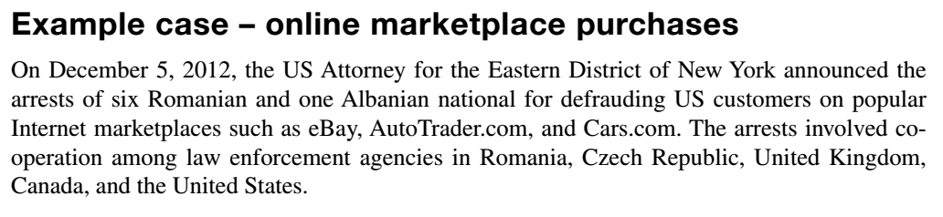
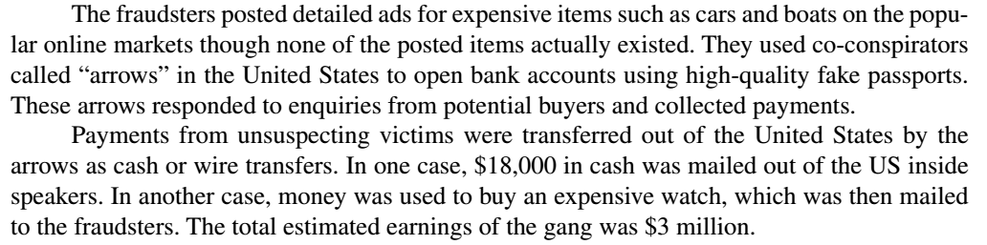
Example Case: Online Marketplace
REFERENCE
http://www.justice.gov/usao/nye/pr/2012/2012dec05.html

Slide 52
Example Case Questions
Which standards could have been used to prevent the fraudsters from committing their crimes?
What IT Risk management framework applies best to this case?

Slide 53

Critical Thinking Exercise

Slide 54
Critical Thinking Exercise--Questions
During IT risk assessment, what are some ways that estimation biases can lead to overestimation of insignificant risks and underestimation of important risks?
It is suggested that overestimation of a risk necessarily leads to an under-recognition of some other important risk. Do you agree with this assessment? Why, or why not?

Slide 55
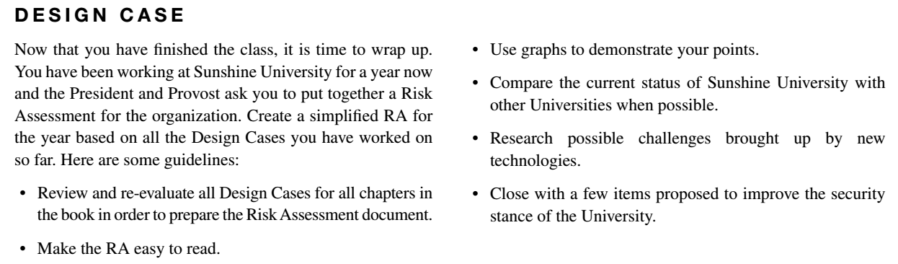
Design Case

Slide 56
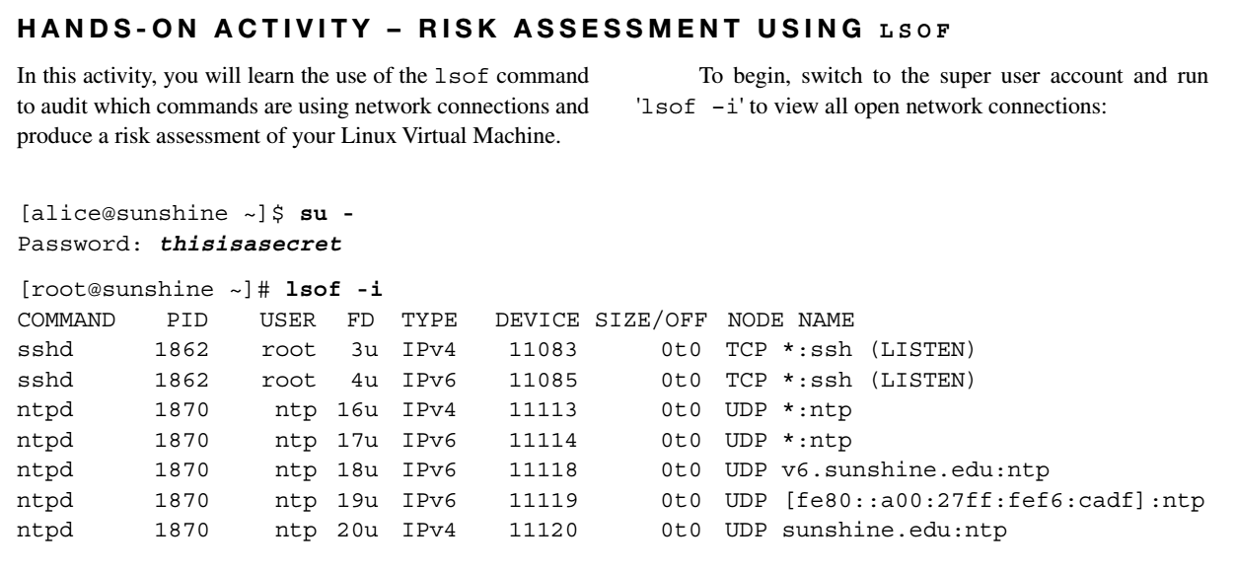
Hands-On Activity

Slide 57
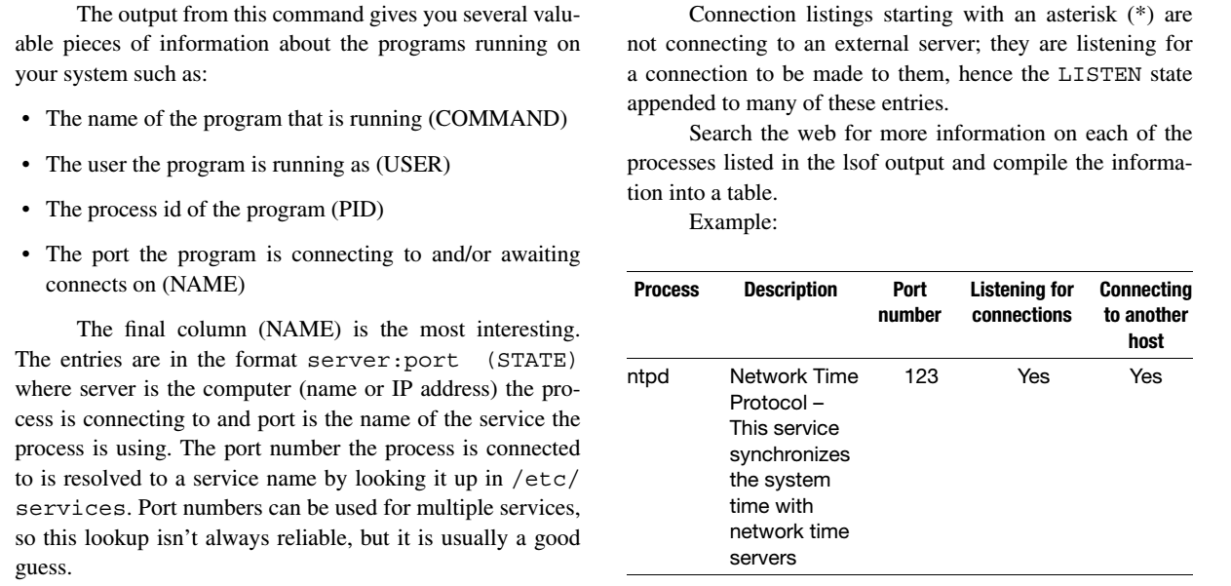
Hands-On Activity

Slide 58
Discussion 15
POST (due WED 11:59 pm CST): Complete the Hands-On activity in this chapter and post your answer to the following question:
In your opinion, what services (if any) could be a security risk and may need to be disabled?
RESPONSES (due FRI 11:59 pm CST): Respond to two of your peers. Evaluate their analysis of the incident and determine what other controls could be put in place to mitigate the risk instead of simply disabling a service.

Slide 59
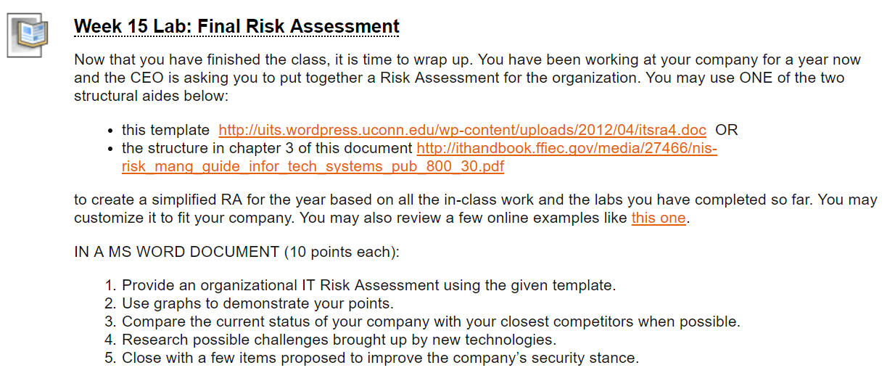
Homework Lab_15

Slide 60
Summary
Explain the relevance of risk management to top management
Describe IT Risk management frameworks
Perform Risk analysis - identification and assessment
Perform Risk management - mitigation, preparation and response

Slide 61
Course Final

Slide 62

For Next Week: Course Final
Format
Randomized 50-question multiple-choice and multiple-answer exam covering the material throughout the course.
You can earn 100 points (2 points per correct and complete answer)
You have 60 minutes to complete the exam.
ONLINE (Blackboard)
What are you allowed to use for the Course Final?
The course slides
The books
What are you not allowed to do during the Final?
Use the internet to find results for questions
Collaborate with your classmates/ friends/ colleagues/ supervisors/ employees etc. or ask a friend to take the exam for you.
Take and share screenshots of exam questions

Slide 63
For Next Week: Course Final
To be successful in the Course Final, please ensure that you are either on an EXCELLENT wireless network (4 or 5 bars) or connected to an ethernet LAN. Please be warned that, when accessed remotely, Blackboard connectivity can time out and self-submit your Course Final BEFORE the allotted time has expired. This is why your best options are:
Take the exam ON CAMPUS, preferably IN THE LIBRARY, or in GEM-125 (the Gellersen computer lab) on one of the Unix machines
Connect your laptop to a wired network if you have to be remote
Take the exam EARLY IN THE TIMESLOT, and start RIGHT AWAY, just incase you run into problems with your wireless connection. I cannot emphasize this enough.
Remember that YOU are responsible for the quality of your network connection outside the Valparaiso University campus. While I will be available to assist you through Google Chat and Skype, please note that I will reset timed-out exams only ONCE.

Slide 64

For Next Week: Course Final
To be prepare for the Course Final, please:
Review all the slide decks for the course
Redo the hands-on exercises
Ensure you can answer all the chapter review questions

Slide 65

Thank you for a great semester!
sonja.streuber@valpo.edu

